Slide 1


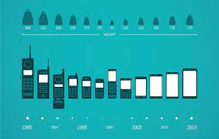
Machine Learning Capstone Project
Supervised Learning:
Classification
Topic: Mobile Price Range Prediction
Submitted by- Subhasis Chattopadhyay
E-mail id: subhasischattopadhyaydbb@gmail.com

Slide 2

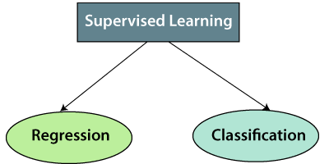
What is Supervised Learning?
Supervised Learning is a ML model in which the model learns by example. Along with our input variable, we also give our model the corresponding correct labels. While training, the model gets to look at which label corresponds to our data and hence can find patterns between our data and those labels.
They are of two types- Regression and Classification

Slide 3
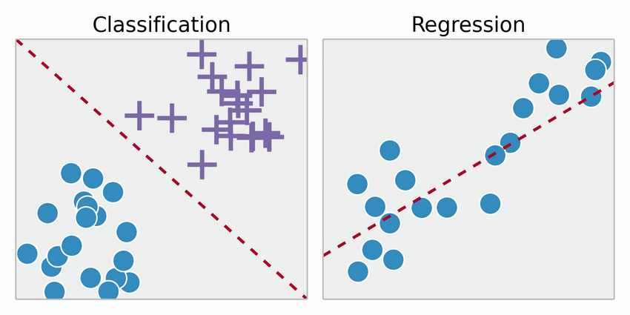
What is Classification?
Classification is defined as the process of recognition, understanding, and grouping of objects and ideas into preset categories also known as “sub-populations.” With the help of these pre-categorized training datasets, classification in machine learning programs leverage a wide range of algorithms to classify future datasets into respective and relevant categories.
How is Classification different from Regression?
The basic difference classification and regression is that classification algorithm predicts discrete class labels where as regression predicts continuous values.

Slide 4
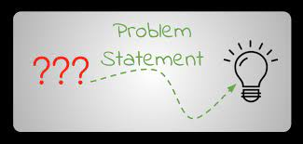

Problem Statement:
The mobile phone companies want to understand mobile sales data and analyse the factors that affects prices.
In this project, we would find out relations between mobile phone features and its selling price, we would not predict exact price but we would predict the price range indicating how high or how low the price is.

Slide 5

Topics to discuss:
Data description
Data summary
Exploratory Data Analysis
Data pre-processing
Machine Learning model implementation
Model Evaluation
Conclusion

Slide 6
Data Description
This dataset contains information about mobile phone features, specifications and their price range. These features and specifications are to be analysed for predictions of price ranges.
Battery_power: Battery capacity in mAh
Blue: Has a bluetooth or not
Clock_speed: Speed at which microprocessor executes instructions
Dual_sim: Has dual sim support or not
Fc: Front camera megapixals
Four_g: Has 4G or not
Int_memory: Internal memory capacity
M_dep: Mobile depth in cm

Slide 7

Data Description
Mobile_wt: Weight of Mobile phone
N_cores: No.of cores in the processor
Pc: Primary camera megapixals
Px_height: Pixal resolution height
Px_width: Pixal resolution width
RAM: Random Access Memory
Sc_h: Screen height
Sc_w: Screen width
Talk_time: Longest that a single battery can last over a call
Three_g: Has 3G or not
Wifi: Has wifi or not
Price_range: This represents the value of mobile phone(0: low cost, 1: medium cost, 2: High cost, 3: Very high cost)

Slide 8

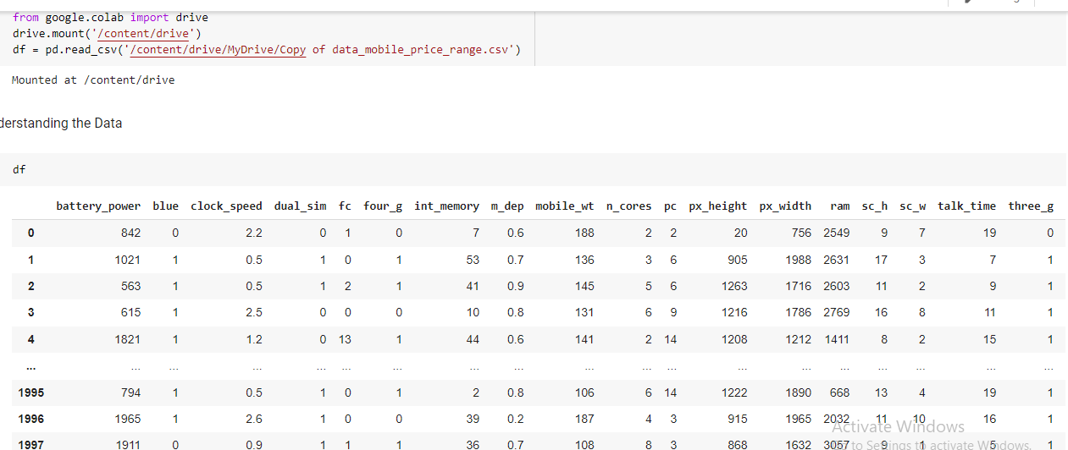
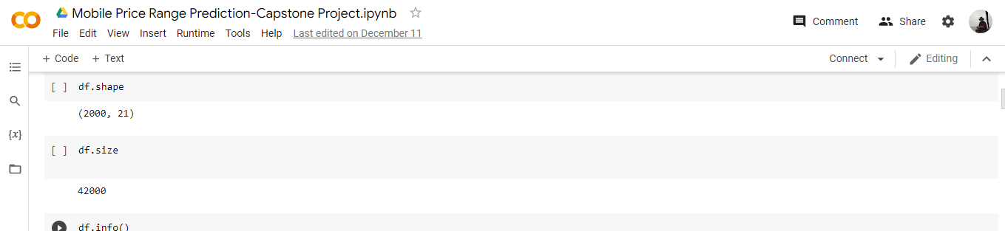
Data Summary
Loading the Dataset
Shape and size of the dataset

Slide 9
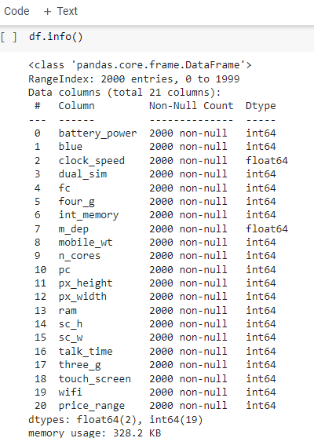

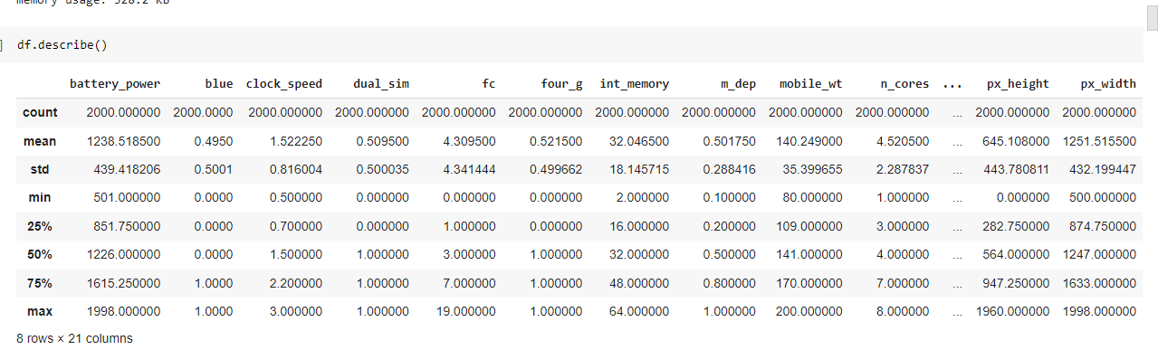
.describe() is used to get information about each and every column of the dataset
.info() is used for information about dataset

Slide 10

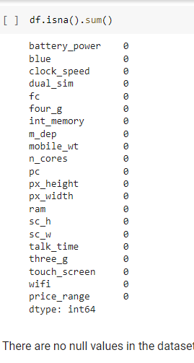
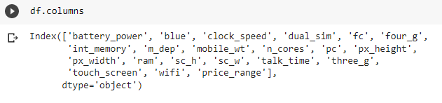
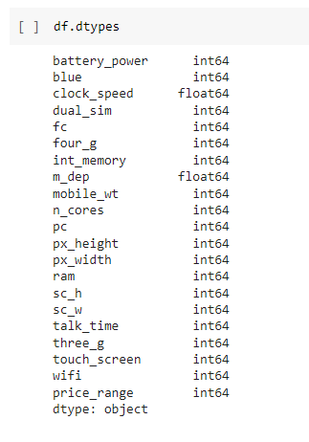
.columns is used to get the names of all the columns in the dataset
.isna() gives us the all the null values present in the Dataset
.dtypes() is used the get the type of data filled in every columns

Slide 11
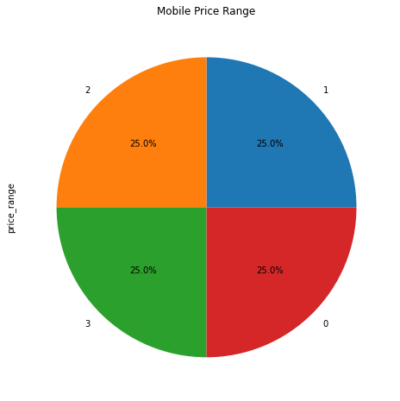
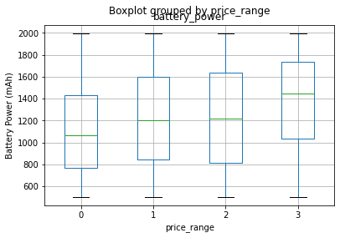
Exploratory Data Analysis
Price
Battery Power
The mobile phones are evenly distributed evenly throughout all the mobile price ranges
The battery power gradually increases with the increase in price range

Slide 12

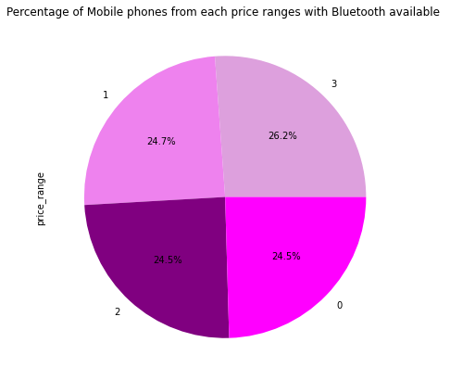
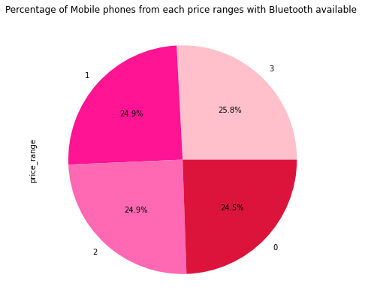
Bluetooth Wifi
Availability of Bluetooth and Wifi are almost evenly distributed throughout mobile phones of all price ranges, therefore it is not an important factor to predict price range

Slide 13
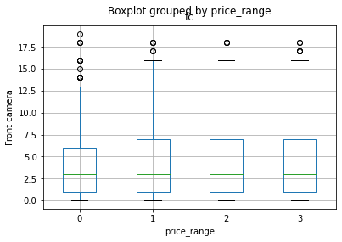
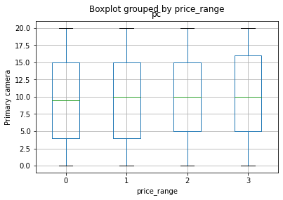
Primary Camera and Front Camera
Front Camera
Primary Camera
FC (front camera megapixels) and PC (Primary camera Megapixels) features distribution is almost similar along all the price ranges but Primary Camera megapixels in low cost phones tends to be poorer.

Slide 14
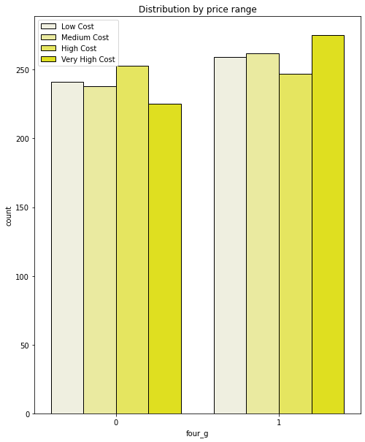
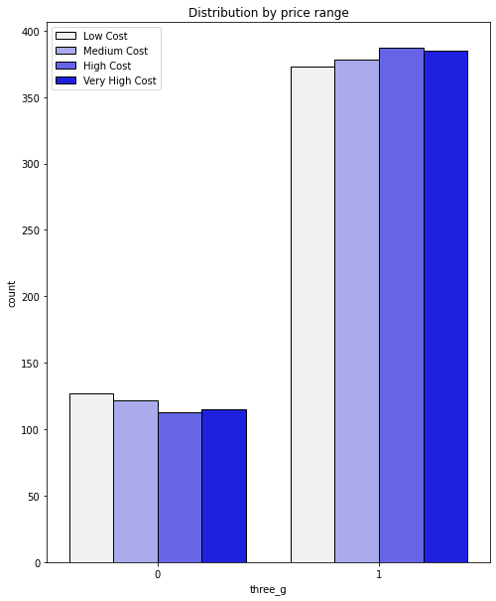
4G and 3G
* Mobile phones supporting 4G is evenly distributed among all price ranges therefore it is not an important feature for price prediction
* 3G will be an important feature for price prediction, the countplot shows a disproportionate number of phones supporting 3G from all price ranges compared to the number of phones not supporting 3G.

Slide 15
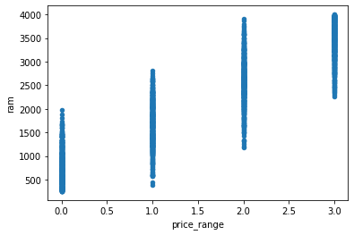
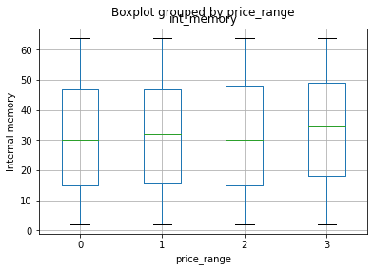
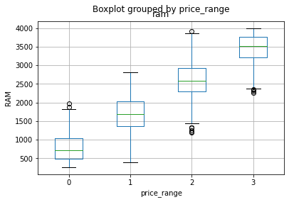
RAM and Internal Memory
RAM increases with increase in mobile price range
Internal memory is slightly higher in mobile phones falling in the very high price ranges.

Slide 16
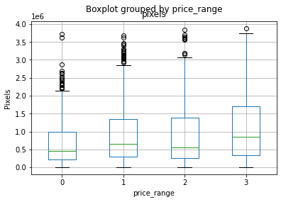
Pixels
Mobiles in higher price range has greater resolution, i.e more pixels per sq inch

Slide 17
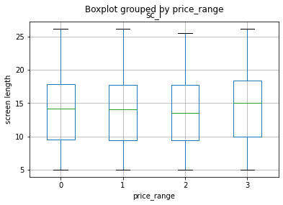
Screen Dimensions
Screen length tends to be higher for phones in the very high price range, so it is an important feature for price prediction.

Slide 18
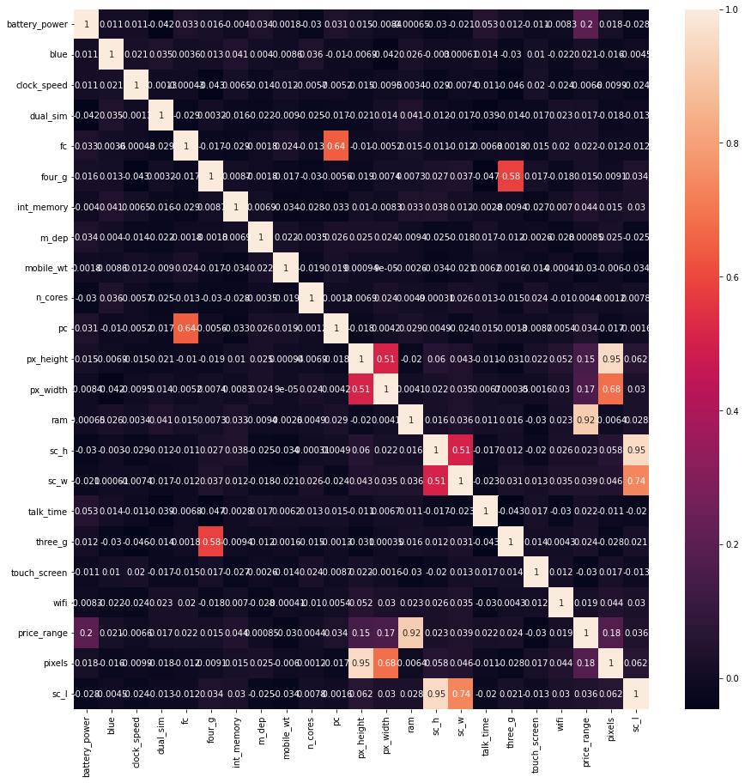
Heatmap
RAM is highly collinear to price range.
Features like pixel height, pixel width and front camera, primary camera are collinear to each other.

Slide 19
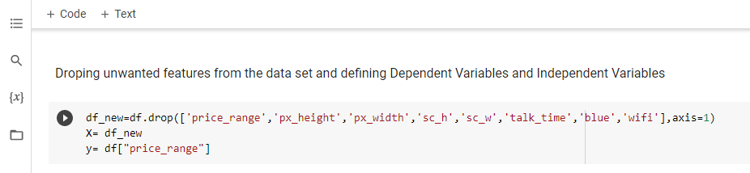
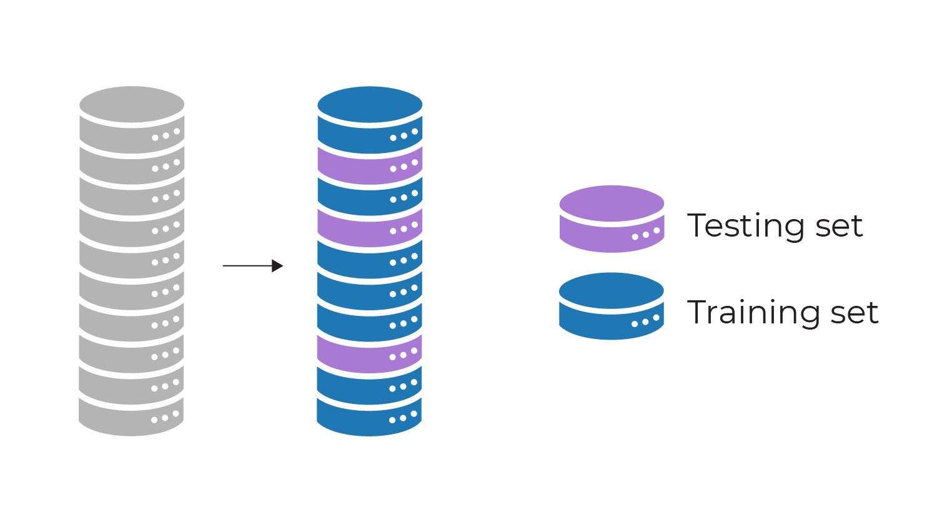
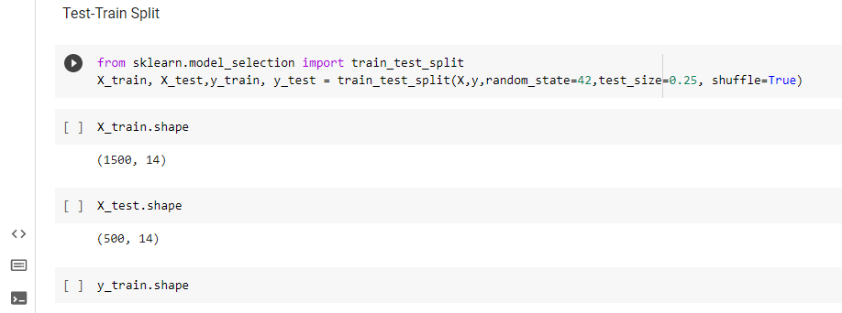
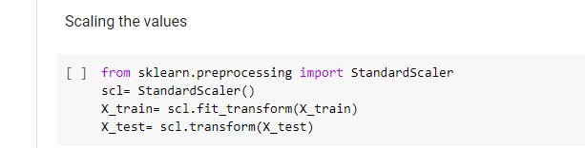
Data Pre-processing
Defining X and y
Test Train Split
Data Scaling

Slide 20
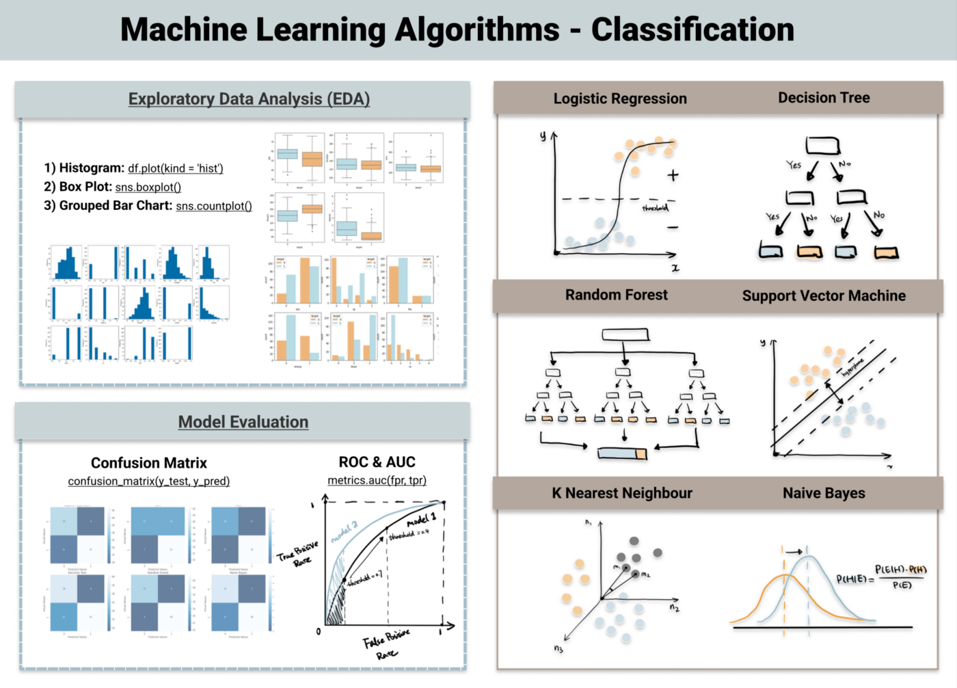

Slide 21
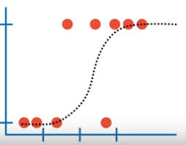
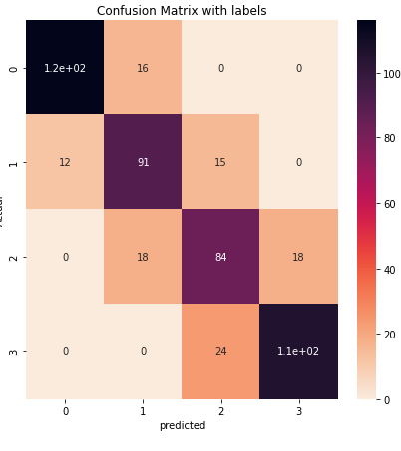
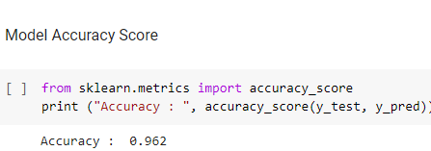
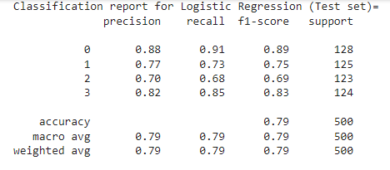
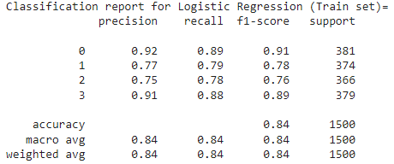
Logistic Regression
Logistic regression is a statistical analysis method to predict a binary outcome, such as yes or no, based on prior observations of a data set.
A logistic regression model predicts a dependent data variable by analyzing the relationship between one or more existing independent variables. These binary outcomes allow straightforward decisions between two alternatives.
A logistic regression model can take into consideration multiple input criteria. Based on historical data about earlier outcomes involving the same input criteria, it then scores new cases on their probability of falling into one of two outcome categories.

Slide 22
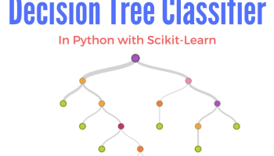
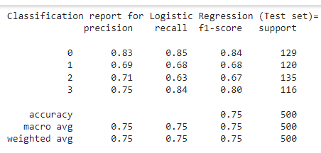
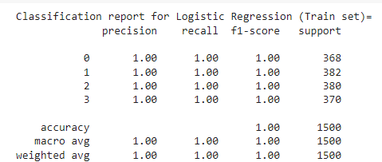
Decision Tree Classifier
Decision Tree is a Supervised learning technique that can be used for both classification and Regression problems, but mostly it is preferred for solving Classification problems. It is a tree-structured classifier, where internal nodes represent the features of a dataset, branches represent the decision rules and each leaf node represents the outcome.
In a Decision tree, there are two nodes, which are the Decision Node and Leaf Node. Decision nodes are used to make any decision and have multiple branches, whereas Leaf nodes are the output of those decisions and do not contain any further branches.
The decisions or the test are performed on the basis of features of the given dataset.
It is called a decision tree because, similar to a tree, it starts with the root node, which expands on further branches and constructs a tree-like structure.

Slide 23
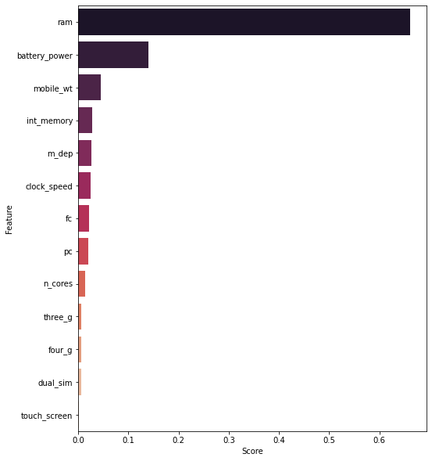
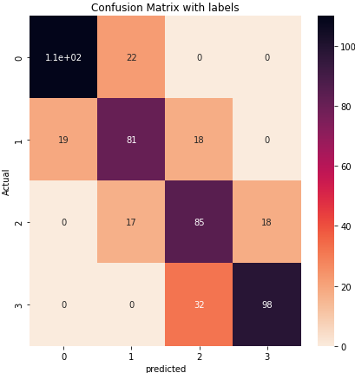
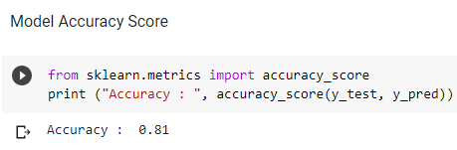
Model Evaluation

Slide 24
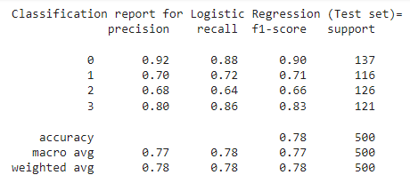
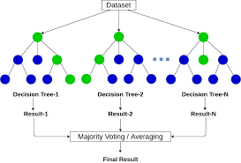
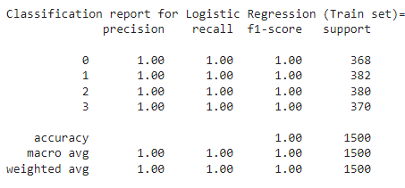
Random Forest Classifier
Random forests are a type of machine learning algorithm that is used for classification and regression tasks. A classifier model takes data input and assigns it to one of several categories. A random forest algorithm works by creating multiple decision trees, each of which is based on a random subset of the data and then averaging their results. This helps to reduce the chance of overfitting, which is when the algorithm only works well on the training data and not on new data.

Slide 25
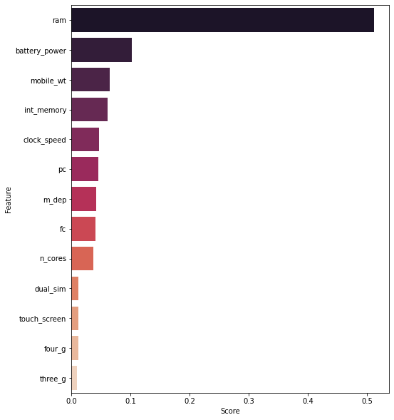
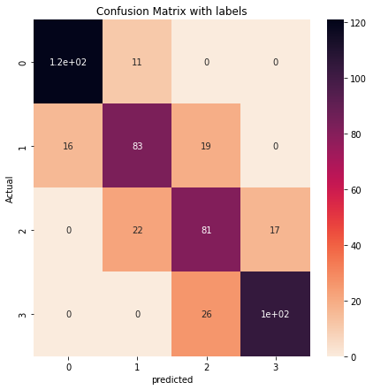
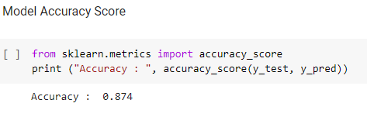
Model Evaluation

Slide 26
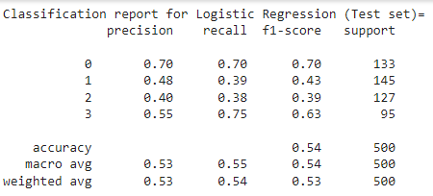
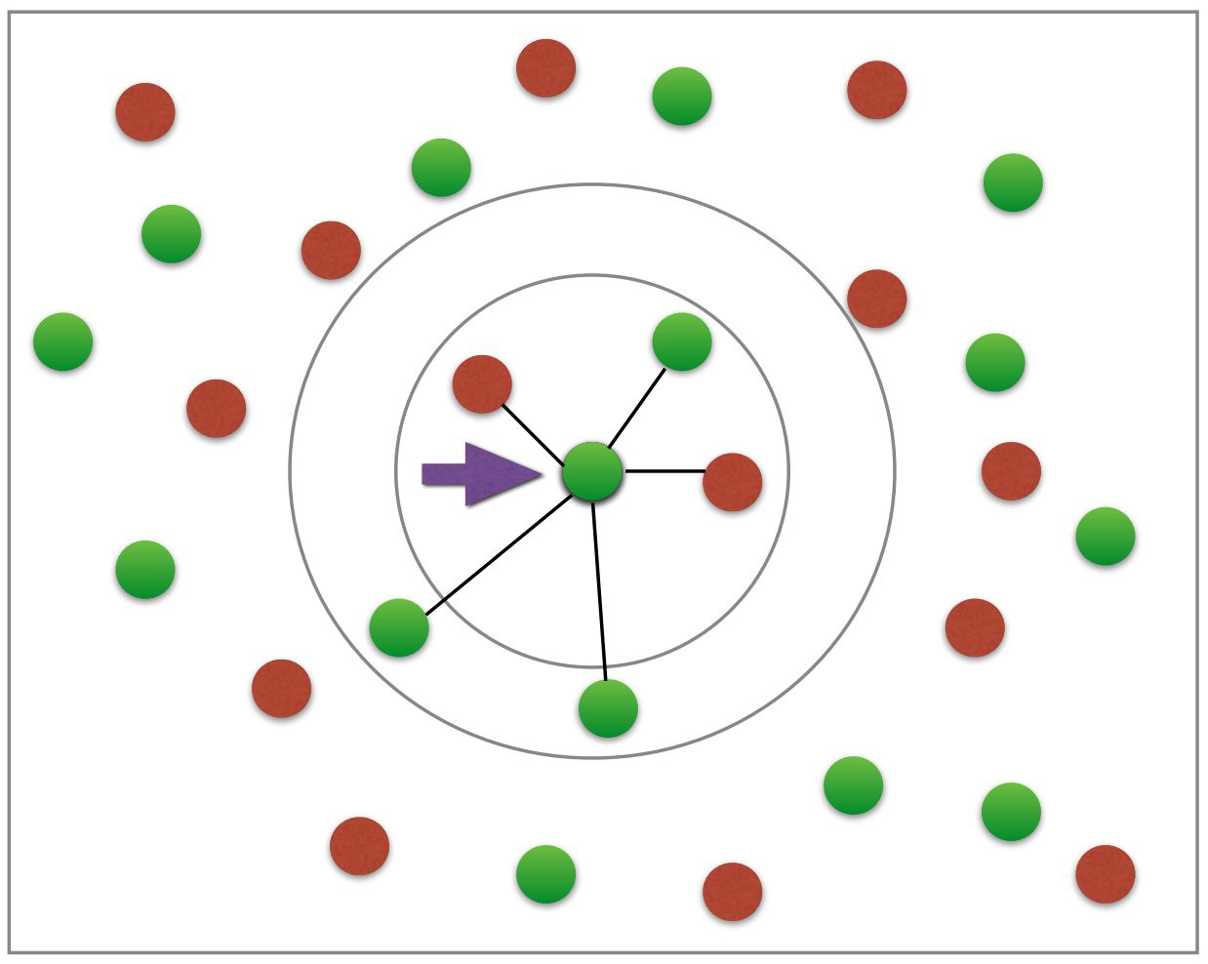
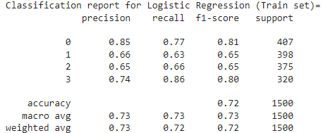
K-Nearest Neighbours
The k-nearest neighbors algorithm(KNN), is a non-parametric, supervised learning classifier, which uses proximity to make classifications or predictions about the grouping of an individual data point. While it can be used for either regression or classification problems, it is typically used as a classification algorithm, working off the assumption that similar points can be found near one another.

Slide 27



Model Evaluation

Slide 28



Support Vector Machine
A support vector machine is a supervised learning algorithm that sorts data into two categories. It is trained with a series of data already classified into two categories, building the model as it is initially trained. The task of an SVM algorithm is to determine which category a new data point belongs in. This makes SVM a kind of non-binary linear classifier.

Slide 29


Model Evaluation

Slide 30

Conclusion
It is clear from EDA that the number of mobile phones in each price range is almost similar.
About half of the device has Bluetooth and wifi and half doesnot
Battery power has a gradual increase with the increase in price range
RAM is continuously increasing with price range
Expensive mobile phones tends to have better Primary camera and Front camera as well as better resolution
In this project, we obtained the best result from Logistic Regression Algorithm with an accuracy of 0.962

